Slide 1
Factors affecting loan default rate
How capable each applicant is of repaying a loan?

Slide 2
Purpose of the project
Should we approve this loan to this particular applicant?
Which factors affect the repayment ability of a client?
Can we predict the income and the amount of loan of an applicant?
Why should we care about this?
1. Credit Risk Model: When the number of customers started growing rapidly, banks around the world desired a system that help them make quick or even automate decisions.
2. Early Warning Indicator (EWS): If we know the importance of each factor, we can predict a new crisis earlier.

Slide 3
Table of some variables and their descriptions
Variable name | Description
TARGET | Target variable (1 - client with payment difficulties: 0 - all other cases)
NAME_CONTRACT_TYPE | Identification if loan is cash or revolving
CODE_GENDER | Gender of the client
CNT_CHILDREN | Number of children the client has
FLAG_OWN_REALTY | Flag if client owns a house or flat
AMT_CREDIT | Credit amount of the loan

Slide 4
Variable name | Description
APARTMENTS_AVG | Apartment size
OCCUPATION_TYPE | What kind of occupation does the client have
CNT_FAM_MEMBERS | How many family members does client have
ORGANIZATION_TYPE | Type of organization where client works
NAME_FAMILY_STATUS | Family status of the client
DAYS_EMPLOYED | How many days before the application the person started current employment
DAYS_BIRTH (age) | Client's age in days at the time of application
AMT_INCOME_TOTAL | Income of the client
*Some of the variable will be modified to run a better regression in Stata*

Slide 5
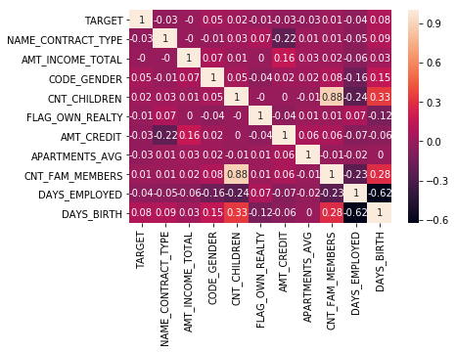

Slide 6
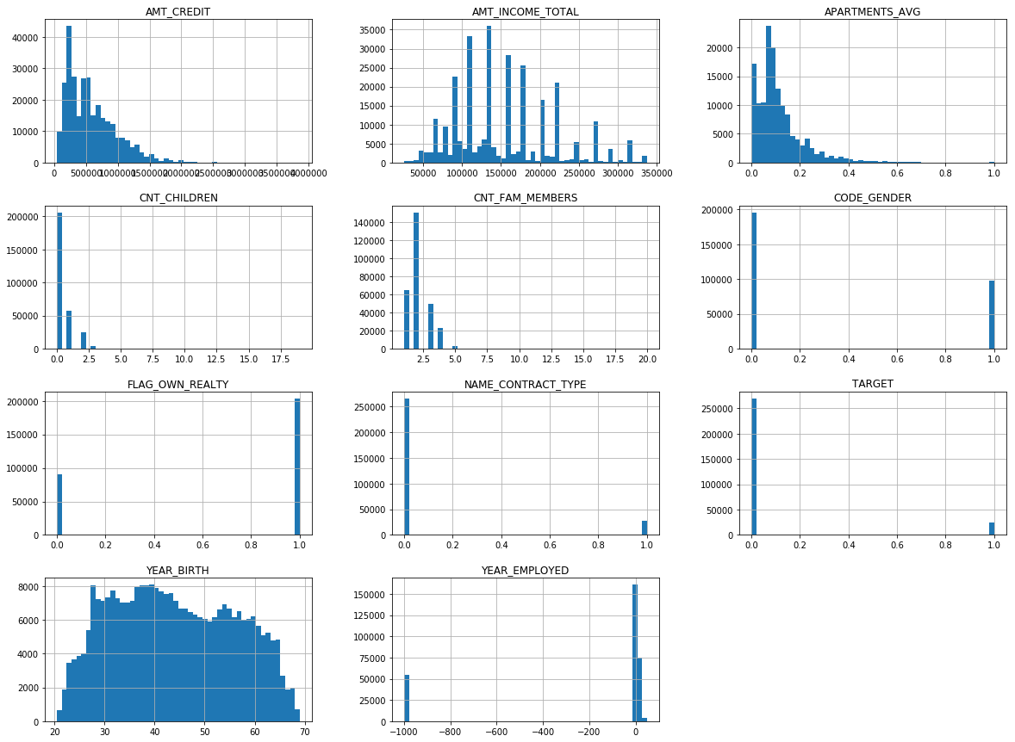

Slide 7
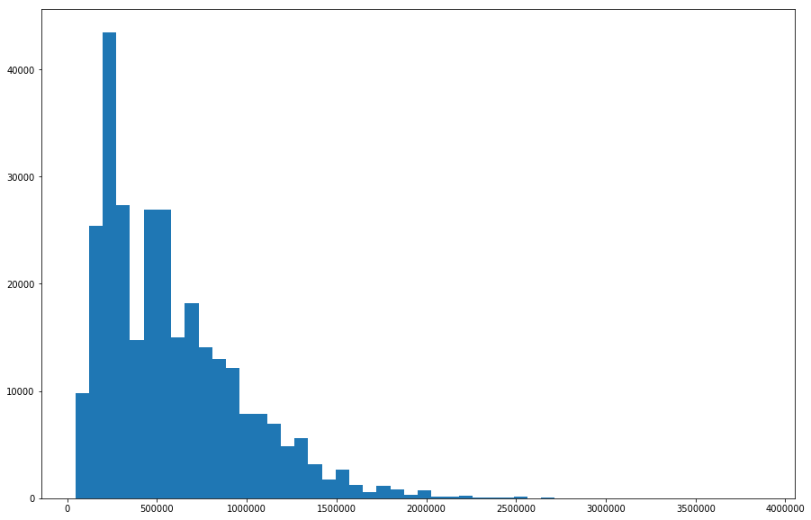
AMT_CREDIT

Slide 8
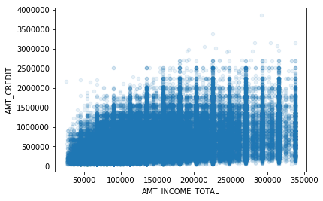
*After getting rid of all the outliers for income (>Q3+(1.5*IQR))

Slide 9
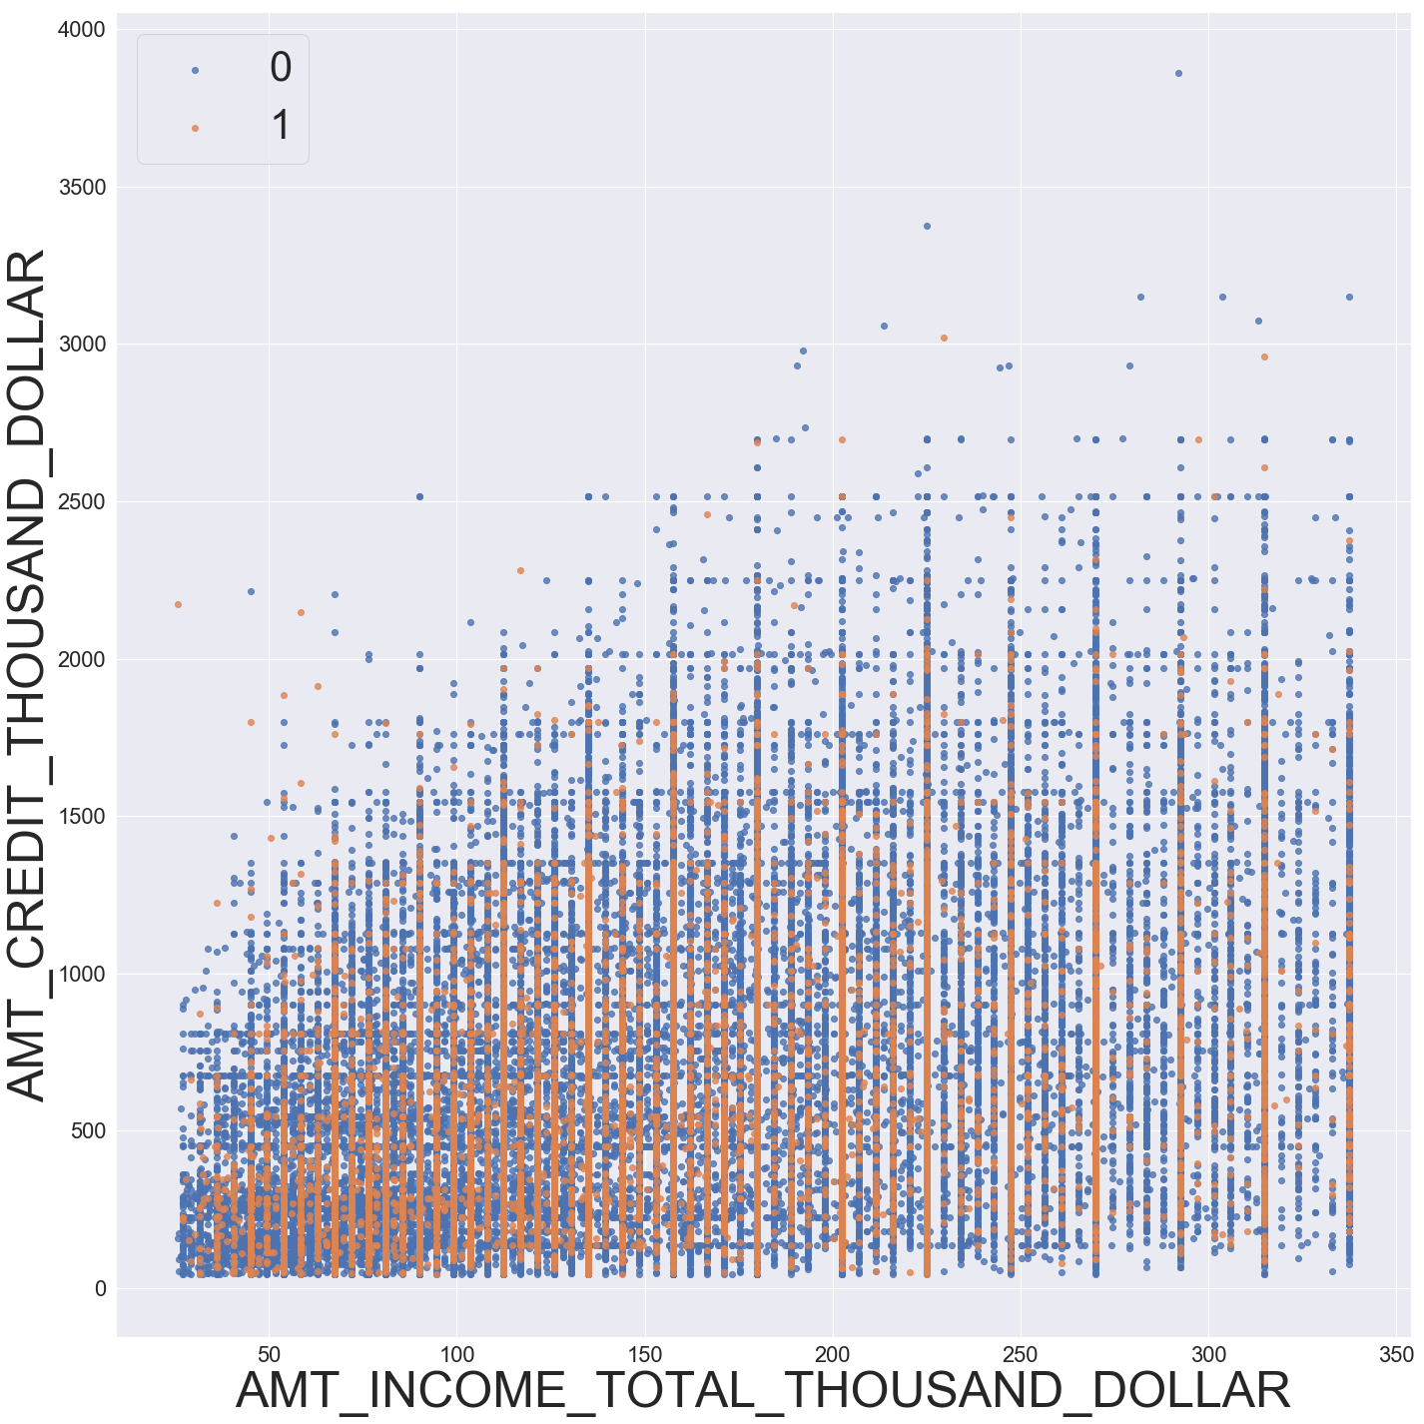

Slide 10

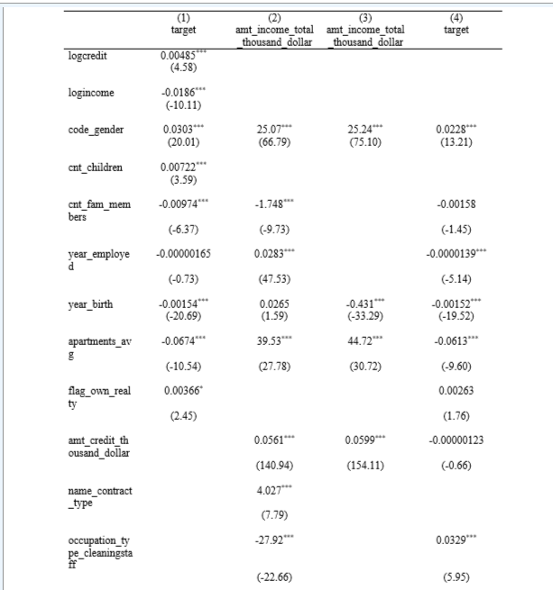
Table with regression result

Slide 11
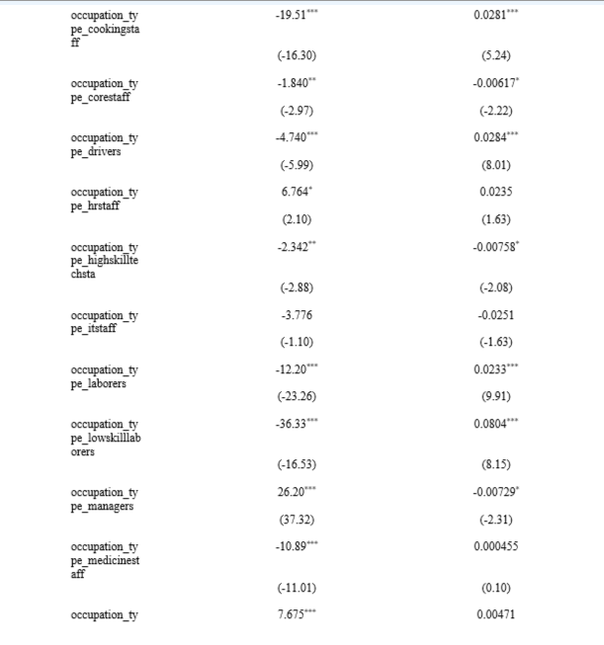

Slide 12
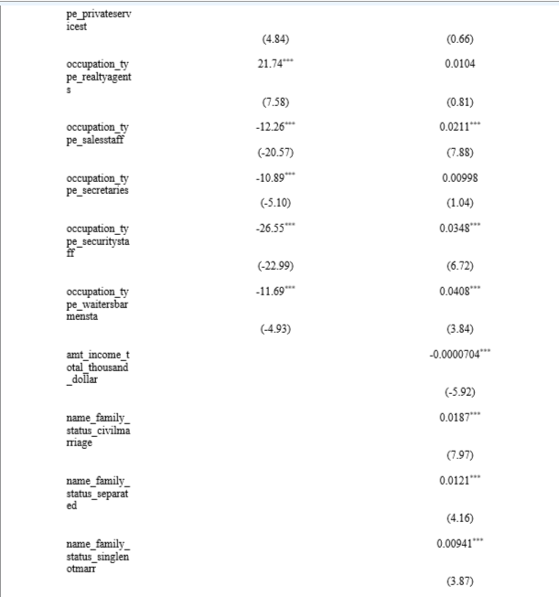

Slide 13
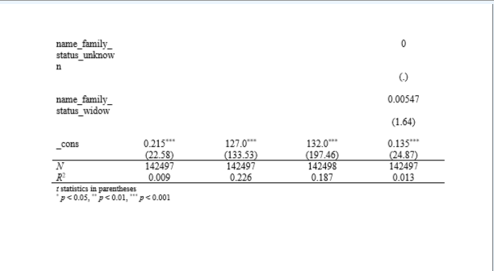

Slide 14

This Photo by Unknown Author is licensed under CC BY-NC-ND

